Slide 1

Southport Parks & Recreation
2026 Budget Proposal

Slide 2
Recreation Program
Before/After School (transportation provided)
Teacher Workdays
Host Supper w/ Santa’s Elves (Winterfest)
Winter Break Camp
Spring Break Camp
Summer Camp (BCS Free Summer Lunch Program)
STEM Program (8 weeks a year)
NSTL-Tennis w/ Power Walking Ministries
Park & Play-Traveling Recreation Activities (Fall 2025)

Slide 3
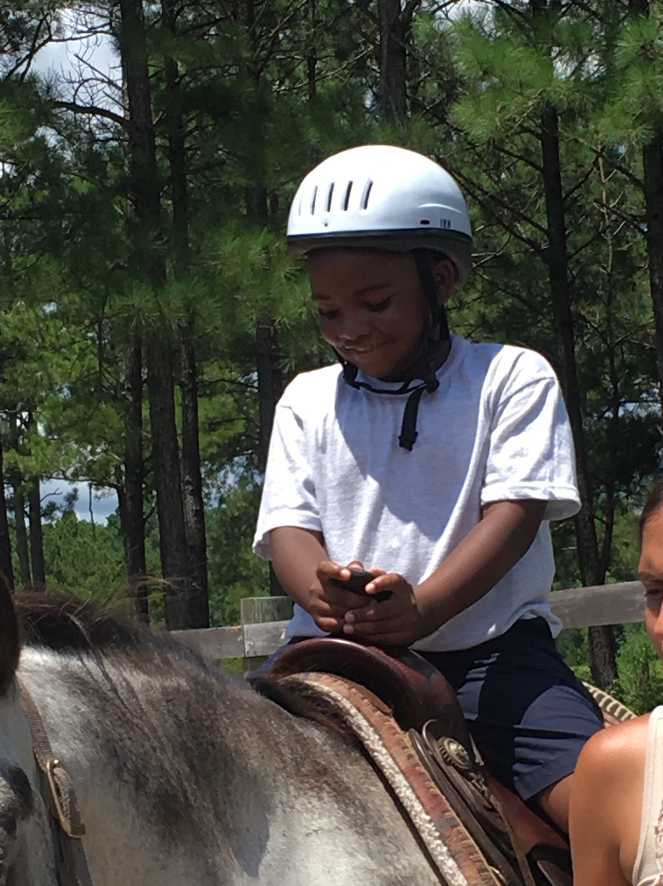
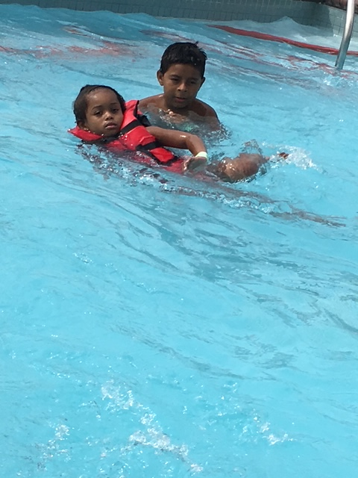
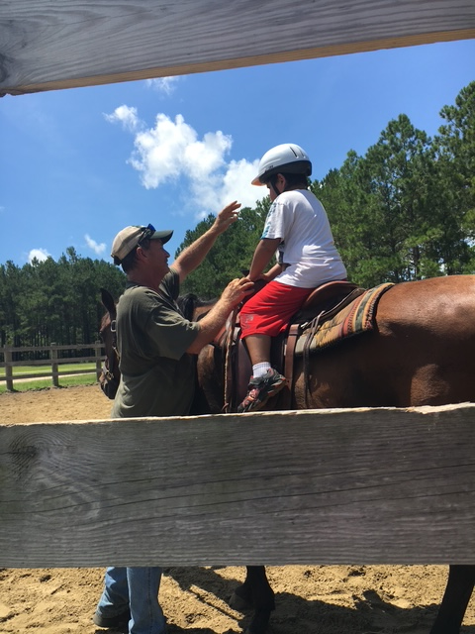
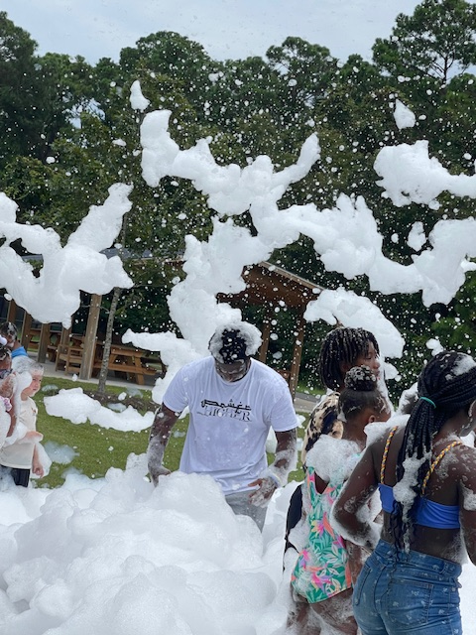
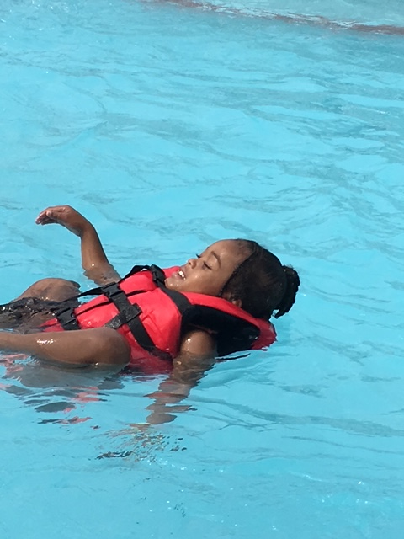
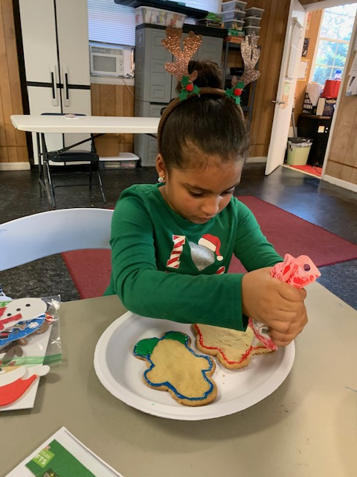

Slide 4
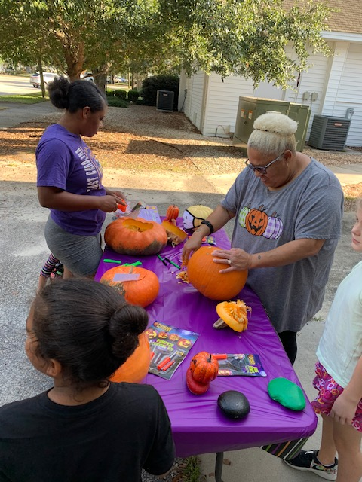
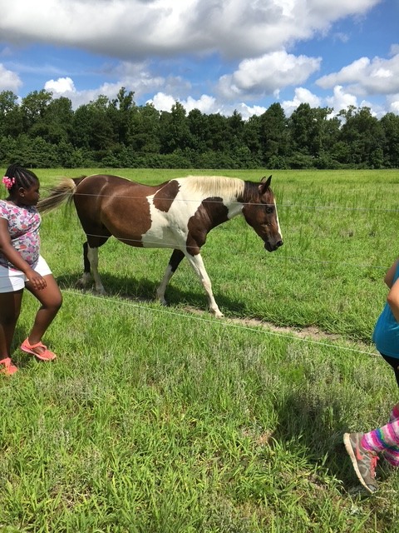
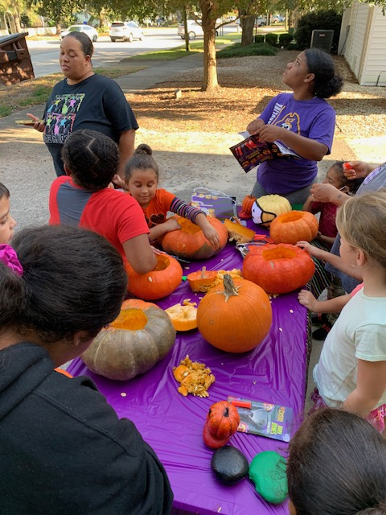
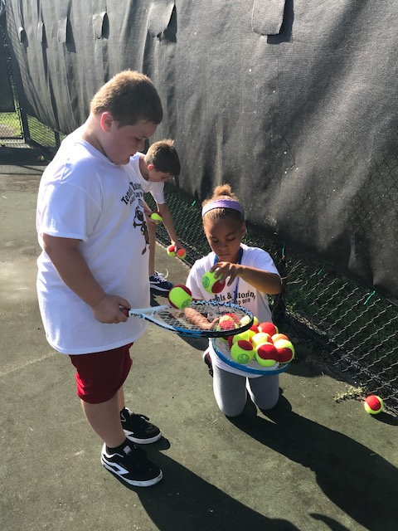
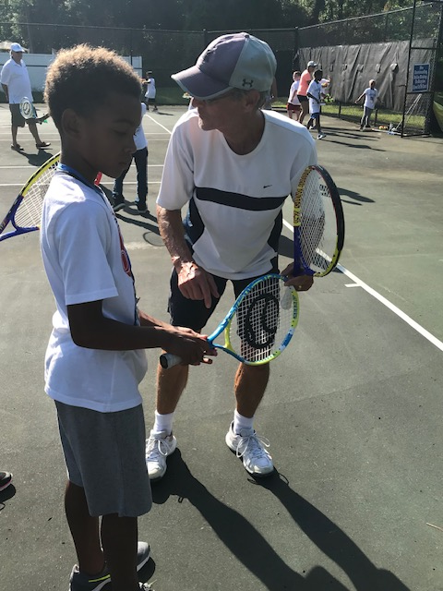

Slide 5
Special Events Hosted by Parks & Rec. Department
Easter Egg Hunt
4th of July Children’s Games
Labor Day Crab Derby
Captain Charlie’s Fishing Tournament
Spook or Treat & Hay-Ride
Santa’s Workshop
Park & Play- Traveling Recreation Activities

Slide 6
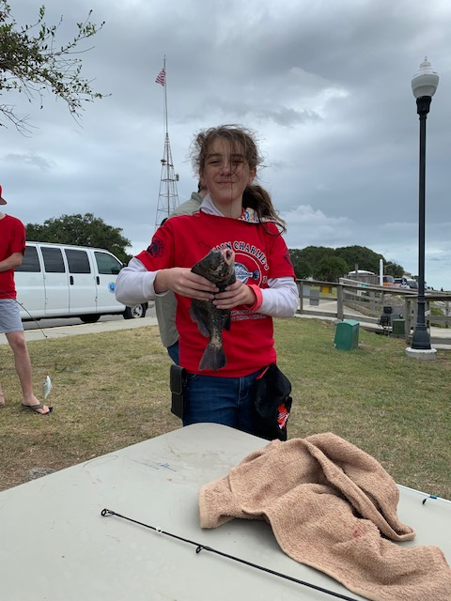
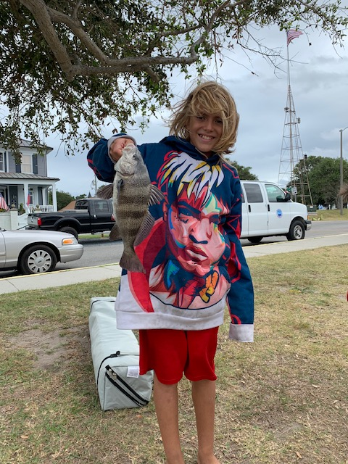
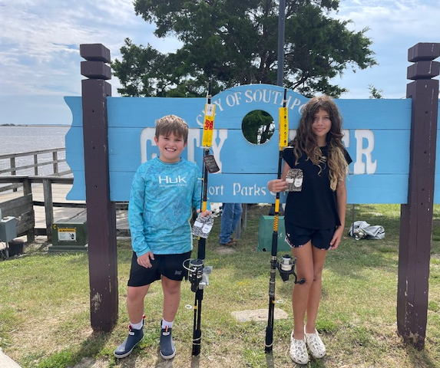
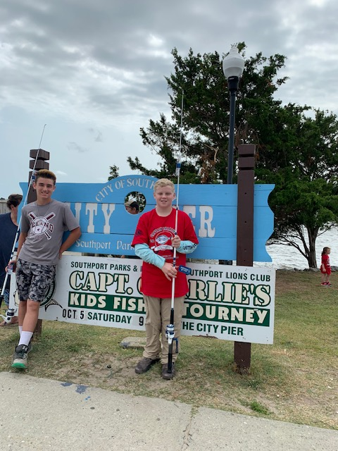
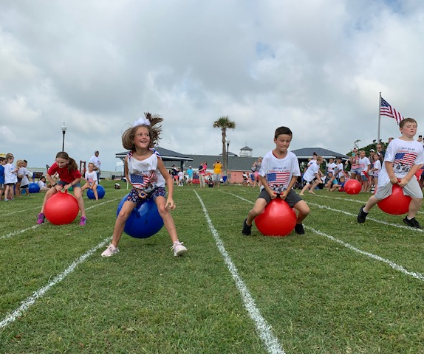
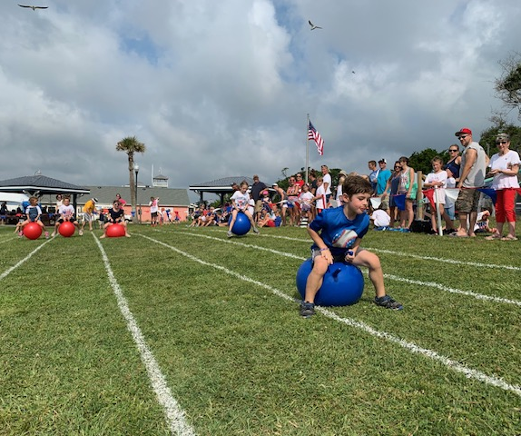

Slide 7
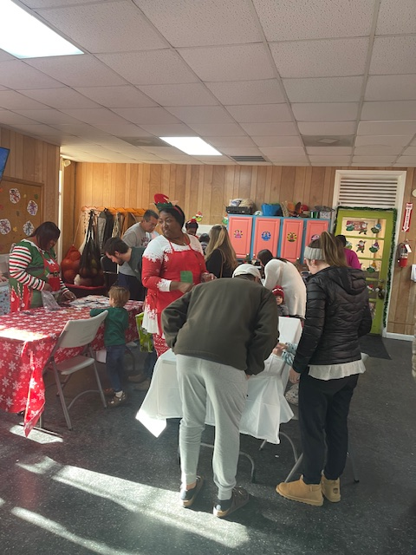
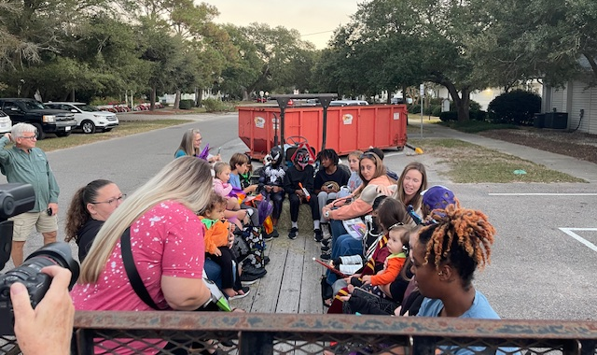
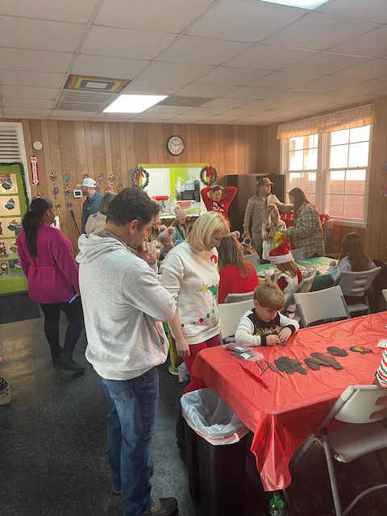
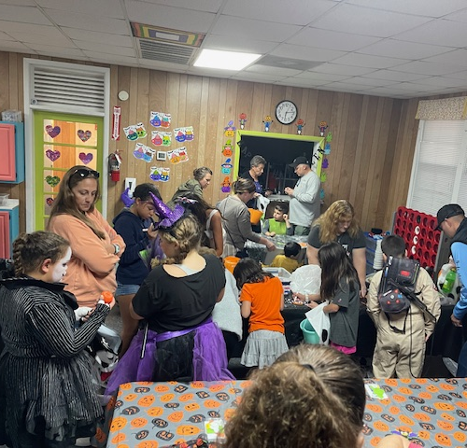
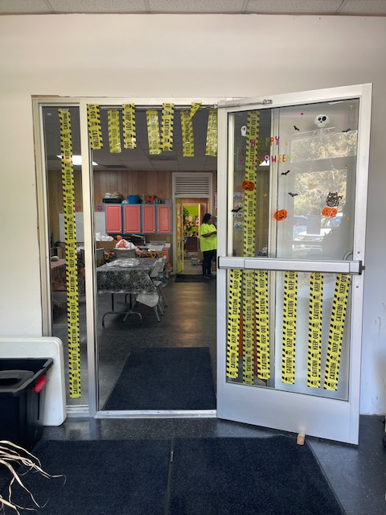
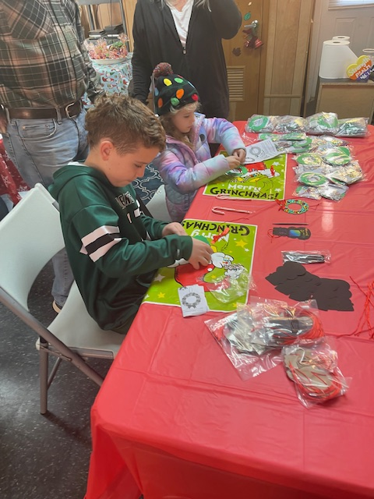

Slide 8
Co-Sponsored Events with CRD
Summer Concert Series
Movies on the Garrison
Farmer’s Market
Winter Fest
Spring Festival

Slide 9
Community Donations
Porch People provide snacks monthly
Locals provide used books for all grade levels
Received mildly used toys and games

Slide 10
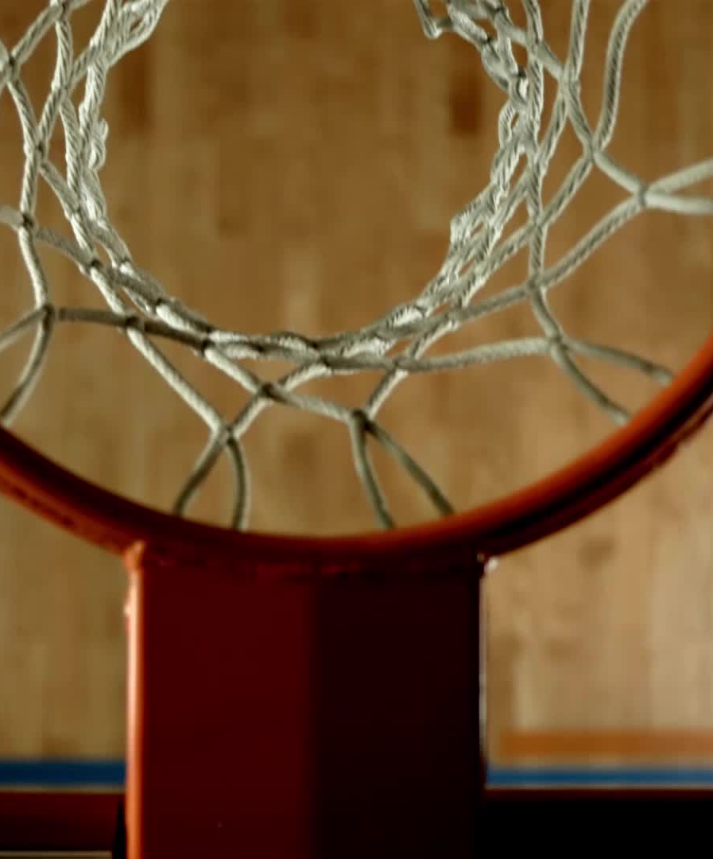
Athletic Activities
Youth Basketball Season
Open Gym for Basketball (5 days a week)
Martial Arts
Yoga
Line Dancing

Slide 11
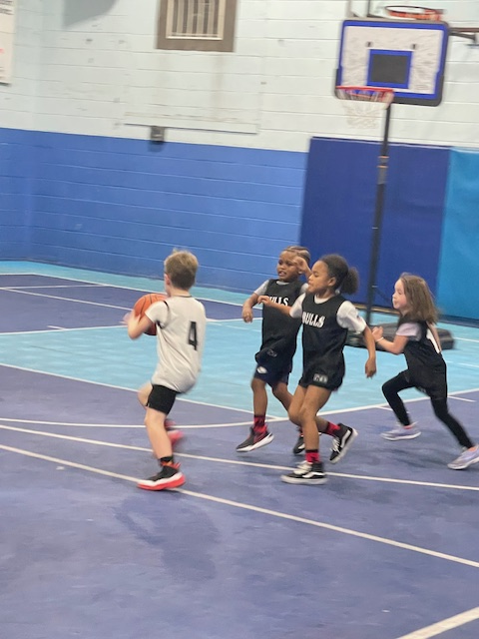
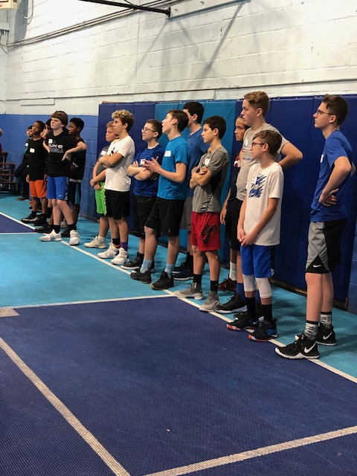
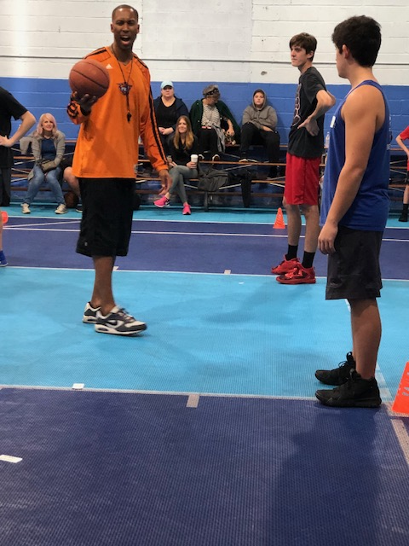
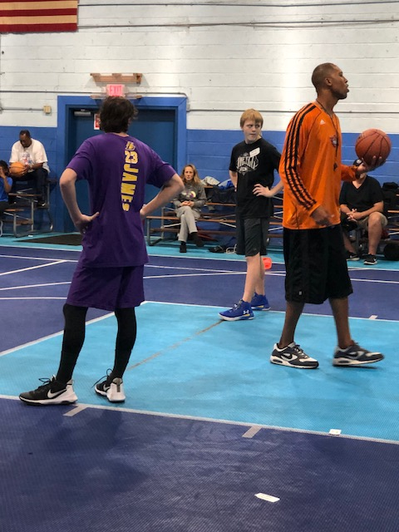
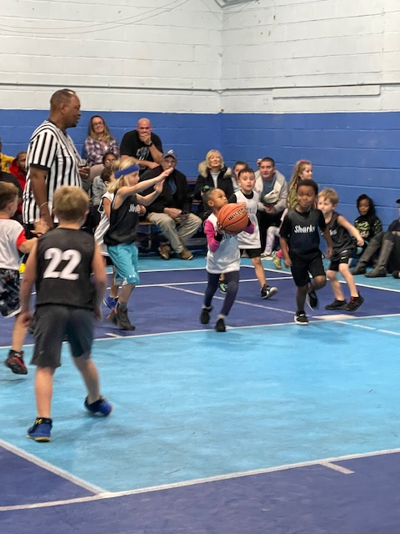
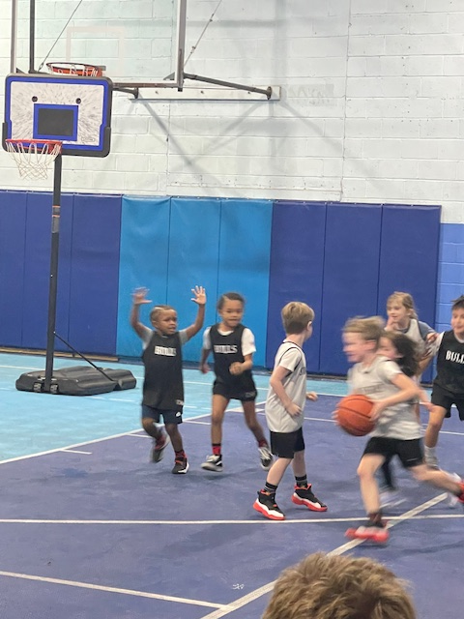

Slide 12

Athletic Activities
Core & Body Sculpting
Outdoor Aerobics (Summer 2025)
Croquette- Free Clinics
Girls Flag Football (Fall 2025)
Walking Program

Slide 13

Senior Activities
Aerobics
Crafts
Road Trips
Monthly Luncheons
Holidays Parties
Morning Coffee & Cards

Slide 14
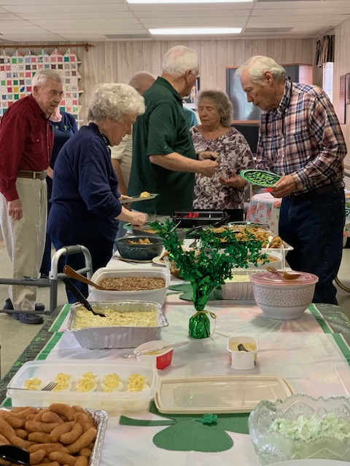
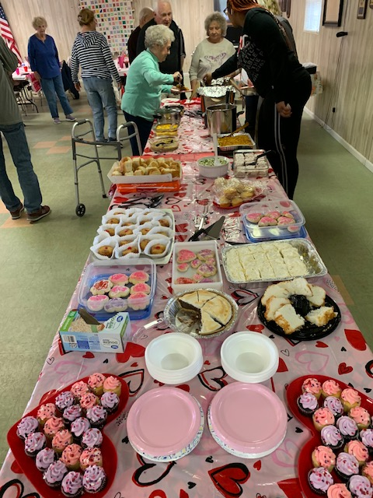
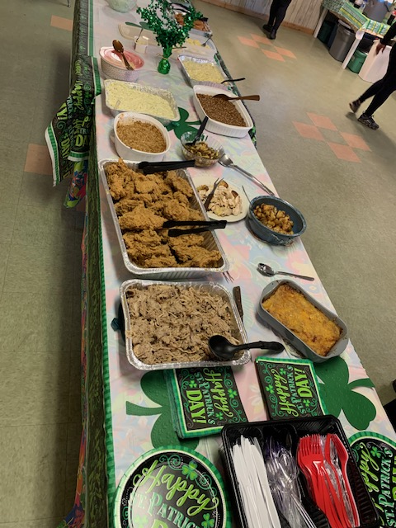
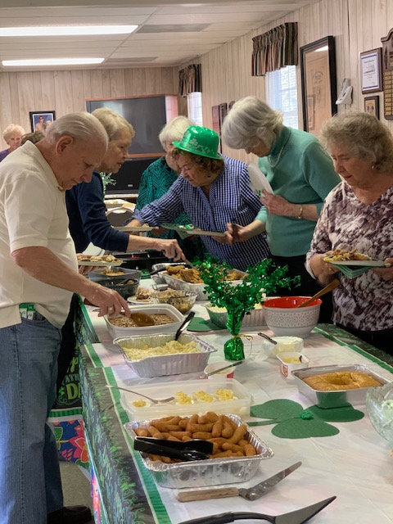
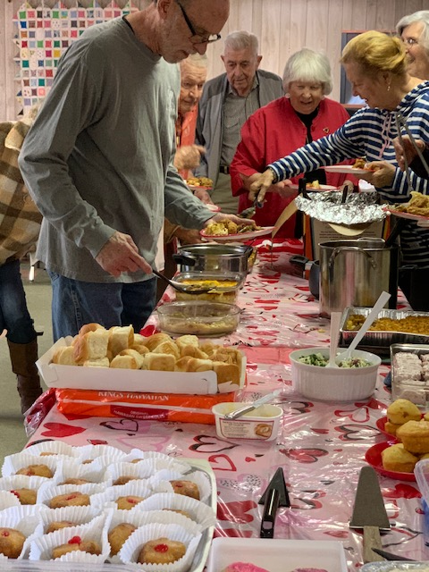

Slide 15
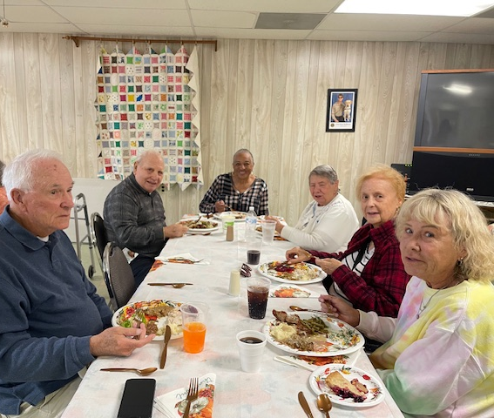
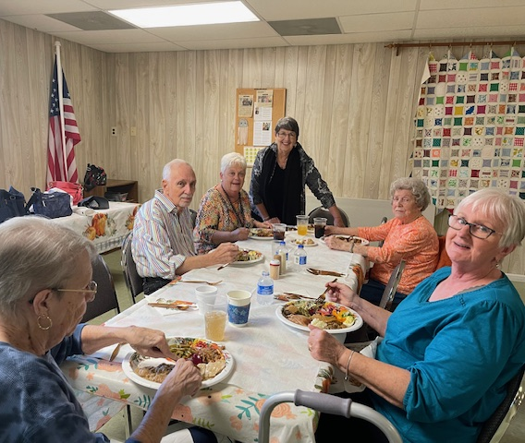
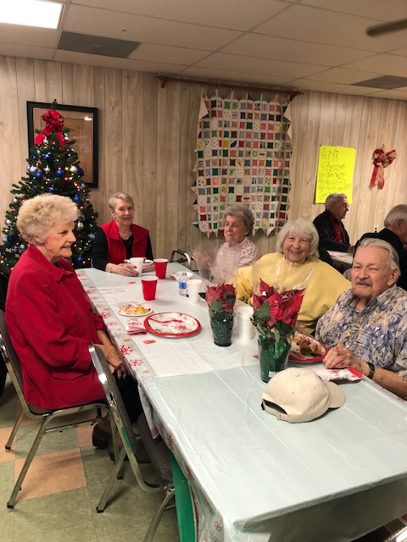
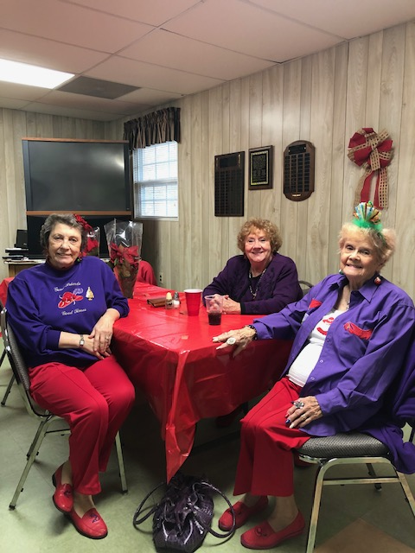
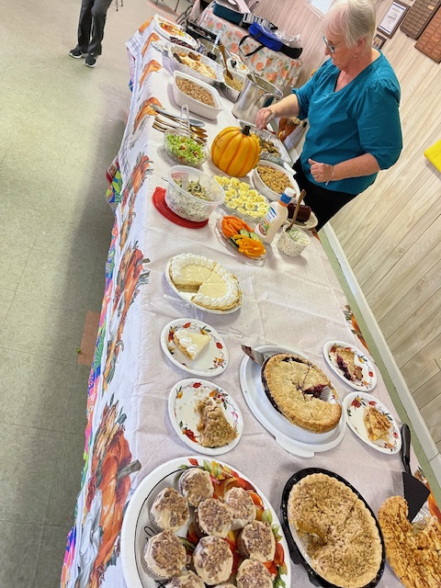

Slide 16
P & R Auxilieries
Rental Buildings
Facilities
Parks

Slide 17
Buildings & Rentals
Central Office
City Gym
Jaycee Building - $150 City Residents/ $250 Non-Residents (4hr minimum)
Senior Building - $150 City Residents/ $250 Non-Residents (4hr minimum)

Slide 18
Facilities
Bay St. Overlook
City Dock
City Pier
Ft. Johnston Tennis Court
Garrison Lawn
Historic Riverwalk
Kayak Launch
Lowe-White Tennis Court
Riverwalk/Salt Marsh Gazebo

Slide 19
Parks
9th St. Park
Atlantic St. Park
Caviness Park
Dog Park
Franklin Square Park
Ft. Johnston Playground
Keziah Park
Kingsley Park
Lowe-White Park
Taylor Field Park
Waterfront Park

Slide 20
Projected Expenses
Athletics 14,960
Recreation Programs 19,250
Seniors 9,150
Special Events 5,200
Supplies 11,190
Total 59,750
Estimate 60,000

Slide 21

Southport Parks & Recreation Department

